Slide 1

DEEP Q-LEARNING
FOR SNAKE AI
Navigating Risk & Reward in a 'Poisoned' Environment
TEAM GUJJU AI
Aryan Hemendra Bhavsar • Zeel Ghanshyambhai Prajapati • Manthan Dharmeshkumar Patel

Slide 2



THE CHALLENGE
STANDARD SNAKE
OUR POISON TWIST
Traditional snake bots are a "solved" problem. They only need to avoid walls and their own tail. The goal is simple pathfinding with zero trade-offs.
We introduced Poison Blocks (-50 penalty). The agent is no longer just pathfinding; it must balance Greed (Food), Safety (Poison), and Survival (Walls).

Slide 3






METHODOLOGY
STATE SPACE
DQN MODEL
REWARD SHAPING
Engineered a custom 16-dimensional boolean vector to give the agent distinct "vision" of food, poison, and obstacles.
Implemented a PyTorch Deep Neural Network to approximate Q-values and predict long-term rewards from current states.
Designed a strictly balanced reward/penalty structure to force discrimination between "good" and "bad" pixels.

Slide 4
THE 16-FEATURE STATE
Instead of processing raw pixels (which is slow), we simplified the input into a high-level boolean vector:
Danger (3 bits): Is a collision imminent Straight, Left, or Right?
Direction (4 bits): Current Heading (North, South, East, West)
Food Direction (4 bits): Is food Up, Down, Left, or Right relative to head?
Poison Direction (4 bits): Is poison Up, Down, Left, or Right?
Tail Proximity (1 bit): Is the tail dangerously close?

Slide 5

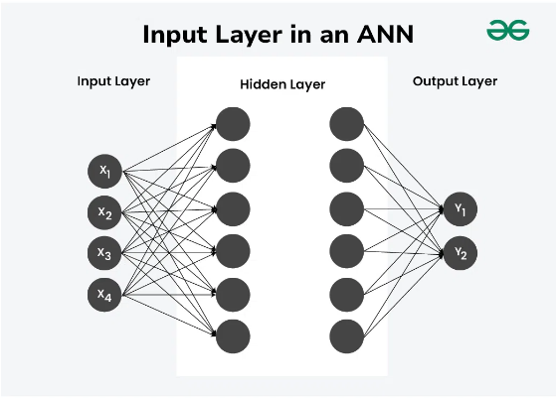
NEURAL ARCHITECTURE
Input Layer
16 Nodes (Feature Vector)
Hidden Layers
512 -> 256 Neurons (ReLU)
Deep enough to capture non-linear risks.
Output Layer
3 Nodes [Left, Straight, Right]
Determines the next move.

Slide 6






REWARD SHAPING
EAT FOOD
EAT POISON
DEATH
+10
-50
-100
The Incentive
The Deterrent (5x Food)
Critical Failure

Slide 7


BASELINE VS. TRAINED
PHASE 1: BASELINE AGENT
PHASE 3: TRAINED DQN
Heuristic / Rule-Based
Deep Q-Network (200 Episodes)
FAILS. It has no concept of hazard types. It treats poison blocks as empty space and dies frequently.
SUCCESS. The agent learned that the 'Poison Input' bit correlates with massive penalties. It actively pathfinds around hazards.
BLIND TO POISON
POISON AWARENESS

Slide 8
TRAINING CONVERGENCE
PERFORMANCE OVER 500 EPISODES
The graph illustrates the agent's journey from randomness to mastery.
•
Exploration Phase: Initial low scores as the agent explores the grid randomly.
•
Exploitation Phase: Rapid increase in scores as the agent utilizes the learned Q-table to maximize rewards.

Slide 9

"
"We transformed a simple arcade game into a complex decision-making task. The agent learned not just to pathfind, but to weigh Risks against Rewards in real-time."

Slide 10
Q & A
Thank you for watching.
github.com/Aryxnh4x/Deep_Q_Learning_for_Snake_AI

